Slide 1

Web Application Development
COMP-229
Fall 2023

Slide 2
Building a Backend with MongoDB, Express, and Node
start with the backend implementation of the MERN skeleton using Node, Express, and MongoDB:
Overview of the skeleton application
Backend code setup
User model with Mongoose
User CRUD API endpoints with Express
User Auth with JSON Web Tokens
Running backend code and checking APIs

Slide 3
Overview of the skeleton application
We will build the skeleton as a basic but fully functioning MERN web application with
user create, read, update, delete (CRUD), and authentication-authorization (auth) capabilities; this will also demonstrate how to develop, organize, and run code for general web applications built using this stack.
The aim is to keep the skeleton as simple as possible so that it is easy to extend and can be used as a base application for developing different MERN applications.

Slide 4
Feature breakdown
In the skeleton application, we will add the following use cases with user CRUD and auth functionality implementations:
Sign up: Users can register by creating a new account using an email address.
User list: Any visitor can see a list of all registered users.
Authentication: Registered users can sign-in and sign-out.
Protected user profile: Only registered users can view individual user details after signing in.
Authorized user edit and delete: Only a registered and uthenticated user can edit or remove their own user account details.

Slide 5
Defining the backend components
we will focus on building a working backend for the skeleton application with Node, Express, and MongoDB.
The completed backend will be a standalone server-side application that can handle HTTP requests to create a user, list all users, and view, update, or delete a user in the database while taking user authentication and authorization into consideration.

Slide 6
User model
The user model will define the user details to be stored in the MongoDB database, and also handle user-related business logic such as password encryption and user data validation.
The user model for this skeletal version will be basic with support for the following attributes:

Slide 7
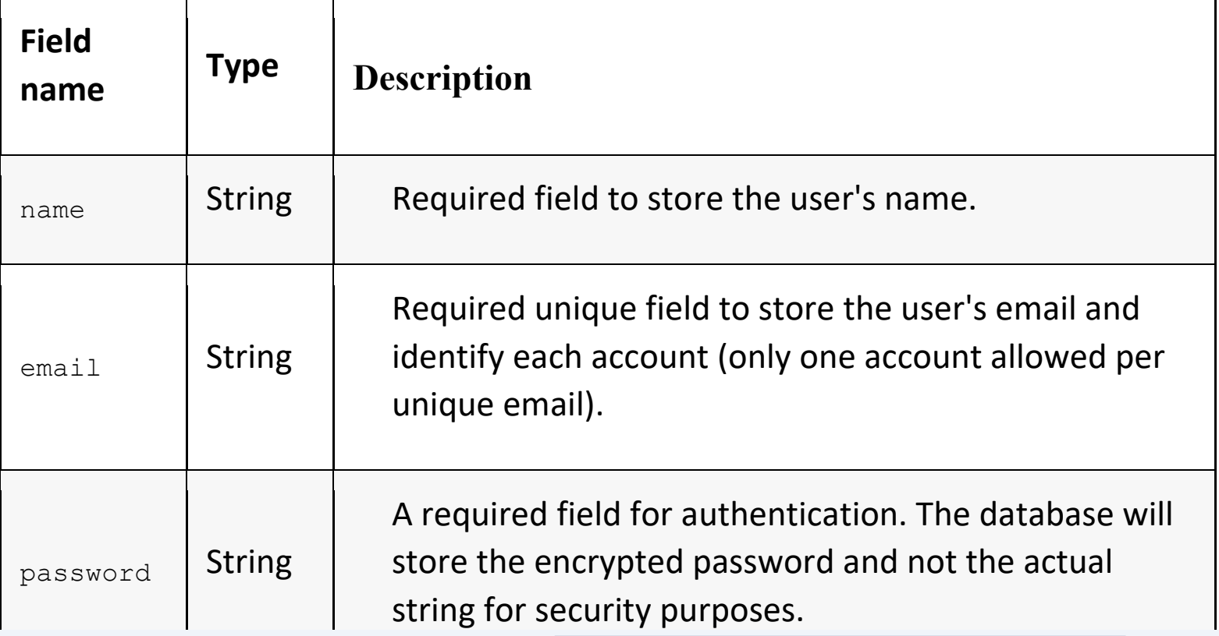
User model contd.

Slide 8
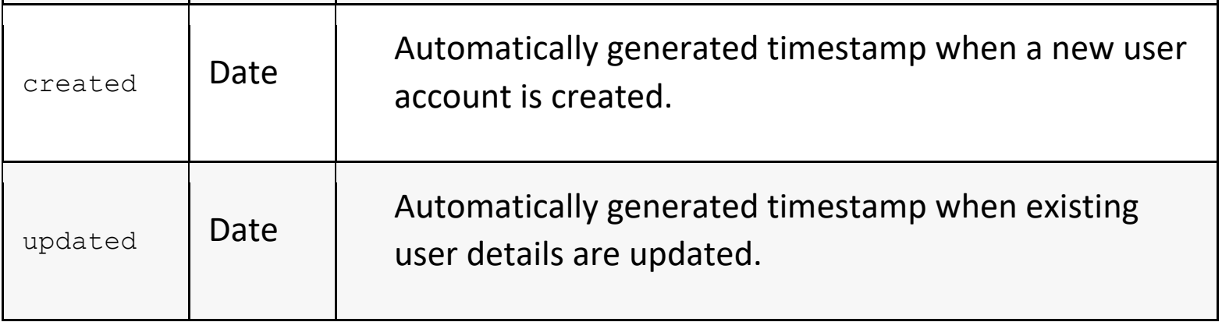
User model contd.

Slide 9
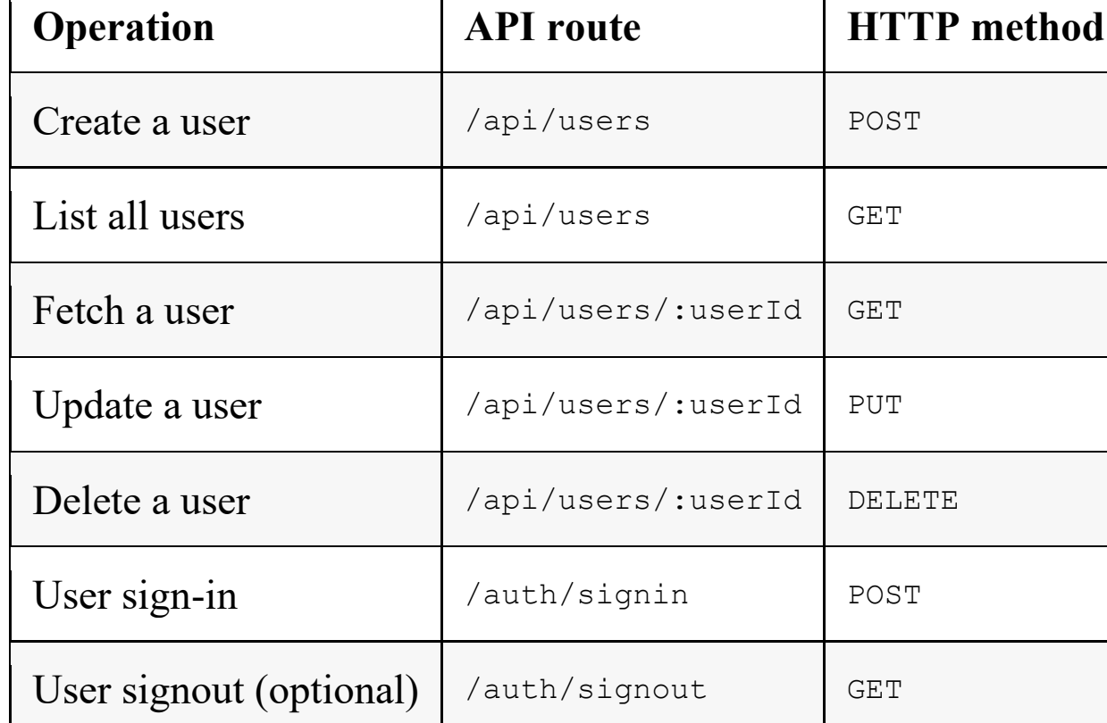
API endpoints for user CRUD
To enable and handle user CRUD operations on the user database, the backend will implement and expose API endpoints that the frontend can utilize in the views, as follows:

Slide 10
Setting up the skeleton backend
To start developing the backend part of the MERN skeleton, we will set up the project folder, install and configure the necessary Node modules, and then prepare run scripts to aid development and run the code.
Then, we will go through the code step by step to implement a working Express server, a user model with Mongoose, API endpoints with Express router, and JWT-based auth to meet the specifications

Slide 11
Folder and file structure
The following folder structure containing files that are relevant to the MERN skeleton backend. With these files, we will have a functioning, standalone server-side application:

Slide 12
Folder and file structure
| mern_skeleton/
| -- config/
| --- config.js
| -- server/
| --- controllers/
| ---- auth.controller.js
| ---- user.controller.js
| --- helpers/
| ---- dbErrorHandler.js
| --- models/
| ---- user.model.js
| --- routes/
| ---- auth.routes.js
| ---- user.routes.js
| --- express.js
| --- server.js
| -- .babelrc
| -- nodemon.json
| -- package.json
| -- template.js
| -- webpack.config.server.js
| -- yarn.lock

Slide 13
Folder and file structure contd.
the configuration files in the root directory and the backend-related code in the server folder.
Within the server folder, we will divide the backend code into modules containing models, controllers, routes, helpers, and common server-side code.
This folder structure will be further expanded in the next chapter, where we'll complete the skeleton application by adding a React frontend.

Slide 14
Initializing the project
If your development environment is already set up, you can initialize the MERN project to start developing the backend.
First, we will initialize package.json in the project folder, configure and install any development dependencies, set configuration variables to be used in the code, and update package.json with run scripts to help develop and run the code.

Slide 15
Adding package.json
We will need a package.json file to store meta information about the project, list module dependencies with version numbers, and to define run scripts.
To initialize a package.json file in the project folder, go to the project folder from the command line and run yarn init, then follow the instructions to add the necessary details.
With package.json created, we can proceed with setup and development and update the file as more modules are required throughout code implementation.

Slide 16
Development dependencies
In order to begin the development process and run the backend server code, we will configure and install Babel, Webpack, and Nodemon,
Babel
Since we will be using ES6+ and the latest JS features in the backend code, we will install and configure Babel modules to convert ES6+ into older versions of JS so that it's compatible with the Node version being used.
we'll configure Babel in the .babelrc file with presets for the latest JS features and specify the current version of Node as the target environment.

Slide 17
Babel update
Update Babel with this new code.
{
"presets": [
["@babel/preset-env",
{
"targets": {
"node": "current"
}
}
],
"@babel/preset-react"
],
"plugins": [
"react-hot-loader/babel"
]
}

Slide 18
Babel Contd.
In this configuration, we specify that we need Babel to transpile the latest
JavaScript syntax with support for code in a Node.js environment and also
React/JSX code. The react-hot-loader/babel plugin is required by the react-hot-
loader module to compile React components

Slide 19
Babel Contd.
Setting targets.node to current instructs Babel to compile against the current version of Node and allows us to use expressions such as async/await in our backend code.
Next install the Babel modules as devDependencies from the command line:
yarn add --dev @babel/core babel-loader @babel/preset-env
Once the module installations are done, you will notice that the devDependencies list has been updated in the package.json file.

Slide 20
Webpack
We will have to configure Webpack to bundle both the client and server code and
the client code separately for production.
Create
webpack.config.client.js,
webpack.config.server.js,
and webpack.config.client.production.js
files in your project folder. All three files will have the following code structure, starting with imports, then the definition of the config object, and finally the export of the defined config object:

Slide 21
Client-side Webpack configuration for development contd.
The highlighted keys and values in the config object will determine how Webpack
bundles the code and where the bundled code will be placed:
mode sets process.env.NODE_ENV to the given value and tells Webpack to use
its built-in optimizations accordingly. If not set explicitly, it defaults to a value of "production". It can also be set via the command line by passing the
value as a CLI argument.

Slide 22
Client-side Webpack configuration for development contd.
devtool specifies how source maps are generated, if at all. Generally, a source map provides a way of mapping code within a compressed file back to its original position in a source file to aid debugging.
entry specifies the entry file where Webpack starts bundling, in this case with the main.js file in the client folder.
output specifies the output path for the bundled code, in this case set to dist/bundle.js.
publicPath allows specifying the base path for all assets in the application.
module sets the regex rule for the file extension to be used for transpilation, and the folders to be excluded. The transpilation tool to be used here is babel-loader.

Slide 23
Client-side Webpack configuration for development contd.
HotModuleReplacementPlugin enables hot module replacement for react-hot-loader.
NoEmitOnErrorsPlugin allows skipping emitting when there are compile errors.
We also add a Webpack alias to point react-dom references to the @hot-loader/react-dom version.
The client-side code of the application will be loaded in the browser from the bundled code in bundle.js.

Slide 24
Server-side Webpack configuration contd.
The mode option is not set here explicitly but will be passed as required when
running the Webpack commands with respect to running for development or building for production.
Webpack starts bundling from the server folder with server.js, then outputs the bundled code in server.generated.js in the dist folder.
During bundling, a CommonJS environment will be assumed as we are specifying commonjs2 in libraryTarget, so the output will be assigned to module.exports.
We will run the server-side code using the generated bundle in server.generated.js.

Slide 25
Client-side Webpack configuration for production contd.
This will configure Webpack to bundle the React code to be used in production mode.
The configuration here is similar to the client-side configuration for development mode, but without the hot-reloading plugin and debug configuration as these will not be required in production.
With the bundling configurations in place, we can add configuration for running these generated bundles automatically on code updates during development using Nodemon.

Slide 26
Webpack
We will need Webpack to compile and bundle the server-side code using Babel.
For configuration, we can use the same webpack.config.server.js
From the command line, run the following command to install webpack, webpack- cli, and the webpack-node-externals module:
yarn add @webpack-cli/generators
****yarn add --dev webpack webpack-cli webpack-node-externals

Slide 27
webpack.config.client.js:
Client-side Webpack configuration for development Update the config object with the following in your webpack.config.client.js file
in order to configure Webpack to bundle and hot-load React code during development:
mern-simplesetup/webpack.config.client.js:
const path = require('path')
const webpack = require('webpack')
const CURRENT_WORKING_DIR = process.cwd()
const config = {
name: "browser",
mode: "development",
devtool: 'eval-source-map',
entry: [
'webpack-hot-middleware/client?reload=true',
path.join(CURRENT_WORKING_DIR, 'client/main.js')
],
output: {
path: path.join(CURRENT_WORKING_DIR , '/dist'),
filename: 'bundle.js',
publicPath: '/dist/'
},
module: {
rules: [
{
test: /\.jsx?$/,
exclude: /node_modules/,
use: ['babel-loader']
}
]
},
plugins: [
new webpack.HotModuleReplacementPlugin(),
new webpack.NoEmitOnErrorsPlugin()
],
resolve: {
alias: {
'react-dom': '@hot-loader/react-dom'
}
}
}
module.exports = config

Slide 28
webpack.config.server.js:
mern-simplesetup/webpack.config.server.js:
const nodeExternals = require('webpack-node-externals')
const config = {
name: "server",
entry: [ path.join(CURRENT_WORKING_DIR , './server/server.js') ],
target: "node",
output: {
path: path.join(CURRENT_WORKING_DIR , '/dist/'),
filename: "server.generated.js",
publicPath: '/dist/',
libraryTarget: "commonjs2"
},
externals: [nodeExternals()],
module: {
rules: [
{
test: /\.js$/,
exclude: /node_modules/,
use: [ 'babel-loader' ]
}
]
}
}

Slide 29
webpack.config.client.production.js:
mern-simplesetup/webpack.config.client.production.js:
const config = {
mode: "production",
entry: [
path.join(CURRENT_WORKING_DIR, 'client/main.js')
],
output: {
path: path.join(CURRENT_WORKING_DIR , '/dist'),
filename: 'bundle.js',
publicPath: "/dist/"
},
module: {
rules: [
{
test: /\.jsx?$/,
exclude: /node_modules/,
use: [
'babel-loader'
]
}
]
}
}

Slide 30
Nodemon
To automatically restart the Node server as we update our code during development, we will use Nodemon to monitor the server code for changes. Install it using the command below:
yarn add --dev nodemon
Before we add run scripts to start developing and running the backend code, we will define configuration variables for values that are used across the backend implementation.

Slide 31
Nodemon contd.
mern-simplesetup/nodemon.json:
{
"verbose": false,
"watch": [ "./server" ],
"exec": "webpack --mode=development --config webpack.config.server.js && node ./dist/server.generated.js"
}

Slide 32
Config variables
In the config/config.js file, we will define some server-side configuration-related variables that will be used in the code but should not be hardcoded as a best practice, as well as for security purposes.

Slide 33
Config variables
mern-skeleton/config/config.js:
const config = {
env: process.env.NODE_ENV || 'development',
port: process.env.PORT || 3000,
jwtSecret: process.env.JWT_SECRET || "YOUR_secret_key",
mongoUri: process.env.MONGODB_URI ||
process.env.MONGO_HOST ||
'mongodb://' + (process.env.IP || 'localhost') + ':' +
(process.env.MONGO_PORT || '27017') +
'/mernproject'
}
export default config

Slide 34
Config variables contd.
The config variables that were defined are as follows:
env: To differentiate between development and production modes
port: To define the listening port for the server
jwtSecret: The secret key to be used to sign JWT
mongoUri: The location of the MongoDB database instance for the project
These variables will give us the flexibility to change values from a single file and use it across the backend code.
Next, we will add the run scripts, which will allow us to run and debug the backend implementation.

Slide 35
Running scripts
To run the server as we develop the code for only the backend, we can start with
the yarn development script in the package.json file. For the complete skeleton application.
mern-skeleton/package.json:
"scripts": {
"development": "nodemon"
}

Slide 36
Running scripts
With this script added, run
yarn add react-hot-loader
yarn add --dev @babel/preset-react
yarn development
in the command line from your project folder will basically start Nodemon according to the configuration in nodemon.json.
The configuration instructs Nodemon to monitor server files for updates and, on update, to build the files again, then restart the server so that the changes are immediately available.

Slide 37
Preparing the server
we will integrate Express, Node, and MongoDB in order to run a completely configured server before we start implementing user-specific features.

Slide 38
Configuring Express
To use Express, we will install it and then add and configure it in the server/express.js file.
From the command line, run the following command to install the express module and to have the package.json file automatically updated:
yarn add express
Once Express has been installed, we can import it into the express.js file,
configure it as required, and make it available to the rest of the app.

Slide 39
Configuring Express contd.
mern-skeleton/server/express.js:
import express from 'express'
const app = express()
/*... configure express ... */
export default app

Slide 40
Configuring Express contd.
To handle HTTP requests and serve responses properly, we will use the following modules to configure Express:
body-parser: Request body-parsing middleware to handle the complexities of parsing streamable request objects so that we can simplify browser-server communication by exchanging JSON in the request body. To install the module, run
yarn add body-parser
from the command line.

Slide 41
Configuring Express contd.
cookie-parser: Cookie parsing middleware to parse and set cookies in request objects. To install the cookie-parser module, run
yarn add cookie-parser
from the command line.
compression: Compression middleware that will attempt to compress response bodies for all requests that traverse through the middleware. To install the compression module, run
yarn add compression
from the command line.

Slide 42
Configuring Express contd.
helmet: Collection of middleware functions to help secure Express apps by setting various HTTP headers/ To install the helmet module, run
yarn add helmet
from the command line.
cors: Middleware to enable cross-origin resource sharing (CORS). To install the cors module, run
yarn add cors
from the command line.

Slide 43
Configuring Express contd.
After the preceding modules have been installed,
Update express.js to import these modules
Configure the Express app before exporting it for use in
the rest of the server code.

Slide 44
Configuring Express contd.
The updated mern-skeleton/server/express.js code should be as follows:
import express from 'express'
import bodyParser from 'body-parser'
import cookieParser from 'cookie-parser'
import compress from 'compression'
import cors from 'cors'
import helmet from 'helmet'
const app = express()
app.use(bodyParser.json())
app.use(bodyParser.urlencoded({ extended: true }))
app.use(cookieParser())
app.use(compress())
app.use(helmet())
app.use(cors())
export default app

Slide 45
Configuring Express contd.
The Express app can now accept and process information from incoming HTTP requests, for which we first need to start a server using this app.

Slide 46
Starting the server
With the Express app configured to accept HTTP requests, we can go ahead and use it to implement a server that can listen for incoming requests.
In the mern-skeleton/server/server.js file, add the following code to implement the server
import config from './../config/config'
import app from './express'
app.get("/", (req, res) => {
res.json({ message: "Welcome to User application." });
});
app.listen(config.port, (err) => {
if (err) {
console.log(err)
}
console.info('Server started on port %s.', config.port)
})

Slide 47
Starting the server
First, we import the config variables to set the port number that the server will listen on and then import the configured Express app to start the server.
To get this code running and continue development, we can
run yarn development
from the command line. If the code has no errors, the server should start running with Nodemon monitoring for code changes.
Next, we will update this server code to integrate the database connection.

